Slide 1
CNN

Slide 2
Convolutional Networks
The Convolution Operation
  Variants of the Basic Convolution Function,
  Structured Outputs,
  Data Types,
  Efficient Convolution Algorithms,
  Random or Unsupervised Features - LeNet, AlexNet.

Slide 3

What is Convolution Operation?
The convolution operation is a mathematical process used to combine two functions or signals to produce a third one.
Convolution computes sum of products at each location.
Convolution operation dramatically transformed image processing by providing a more efficient, scalable, and accurate method of detecting patterns and features in images.

Slide 4
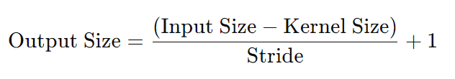
20 | 24 | 11 | 12 | 16 | 19
19 | 17 | 20 | 23 | 15 | 9
21 | 40 | 25 | 13 | 14 | 8
9 | 18 | 8 | 6 | 11 | 22
31 | 3 | 7 | 9 | 17 | 23
20 | 12 | 3 | 11 | 19 | 30
1 | 0 | -1
2 | 0 | -2
1 | 0 | -1
3 x 3 Kernel
6 x 6 Input Matrix
Calculate the Output Matrix Size:
Output Size = 4 x 4 matrix
Output Size = ( ( 6 – 3 ) / 1 ) + 1 = 4

Slide 5
What is a Kernel?
Also known as FILTER.
Als known as FEATURE DETECTOR
A relatively small matrix compared to input matrix size.
The contents of a filter are based on what operations are to be performed on the image.
The kernel SLIDES ACROSS the input data, performing element wise multiplication with corresponding pixels within its bounds, producing a feature map.
This feature map highlights specific patterns or features in the input.

Slide 6
Will differently sized KERNEL produce different convolution result?
Will a KERNEL with different pattern or content produce different convolution result?
What should be the size of the KERNEL?

Slide 7
20 | 24 | 11 | 12 | 16 | 19
19 | 17 | 20 | 23 | 15 | 9
21 | 40 | 25 | 13 | 14 | 8
9 | 18 | 8 | 6 | 11 | 22
31 | 3 | 7 | 9 | 17 | 23
20 | 12 | 3 | 11 | 19 | 30
1 | 0 | -1
2 | 0 | -2
1 | 0 | -1
3
20 | 24 | 11 | 12 | 16 | 19
19 | 17 | 20 | 23 | 15 | 9
21 | 40 | 25 | 13 | 14 | 8
9 | 18 | 8 | 6 | 11 | 22
31 | 3 | 7 | 9 | 17 | 23
20 | 12 | 3 | 11 | 19 | 30
1 | 0 | -1
2 | 0 | -2
1 | 0 | -1
(1×20) + (0×24) + (−1×11) + (2×19) + (0×17) + (−2×20) + (1×21) + (0×40) + (−1×25)
= 3

Slide 8
What is a STRIDE?
A stride in convolutional operations refers to how much the kernel moves across the input matrix during each step of the convolution. It determines the spacing between applications of the kernel over the input data.
  Stride = 1: The kernel moves one pixel (or one element) at a time, both horizontally and vertically. This is the most common setting and ensures that every part of the input matrix is covered.
  Stride > 1: The kernel moves more than one pixel at a time. For example, if the stride is 2, the kernel skips one element between each move, effectively down-sampling the input.

Slide 9
How Stride Affects Output?
Smaller stride (e.g., 1):
  Results in a larger output matrix because the kernel moves less between each application, allowing more overlaps and covering more areas of the input matrix.
Larger stride (e.g., 2 or 3):
  Produces a smaller output matrix because the kernel skips more elements, resulting in fewer positions for the kernel to be applied.

Slide 10
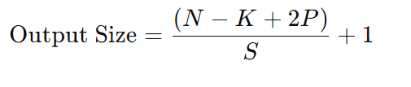
Formula for Output Size
N – input matrix size
K – Kernel matrix size
S – stride value
P – Padding value

Slide 11
20 | 24 | 11 | 12 | 16 | 19
19 | 17 | 20 | 23 | 15 | 9
21 | 40 | 25 | 13 | 14 | 8
9 | 18 | 8 | 6 | 11 | 22
31 | 3 | 7 | 9 | 17 | 23
20 | 12 | 3 | 11 | 19 | 30
1 | 0 | -1
2 | 0 | -2
1 | 0 | -1
1 | 0 | -1
2 | 0 | -2
1 | 0 | -1
20 | 24 | 11 | 12 | 16 | 19
19 | 17 | 20 | 23 | 15 | 9
21 | 40 | 25 | 13 | 14 | 8
9 | 18 | 8 | 6 | 11 | 22
31 | 3 | 7 | 9 | 17 | 23
20 | 12 | 3 | 11 | 19 | 30
3 | 27

Slide 12
1 | 0 | -1
2 | 0 | -2
1 | 0 | -1
20 | 24 | 11 | 12 | 16 | 19
19 | 17 | 20 | 23 | 15 | 9
21 | 40 | 25 | 13 | 14 | 8
9 | 18 | 8 | 6 | 11 | 22
31 | 3 | 7 | 9 | 17 | 23
20 | 12 | 3 | 11 | 19 | 30
3 | 27 | 16
1 | 0 | -1
2 | 0 | -2
1 | 0 | -1
20 | 24 | 11 | 12 | 16 | 19
19 | 17 | 20 | 23 | 15 | 9
21 | 40 | 25 | 13 | 14 | 8
9 | 18 | 8 | 6 | 11 | 22
31 | 3 | 7 | 9 | 17 | 23
20 | 12 | 3 | 11 | 19 | 30
3 | 27 | 16 | 27

Slide 13
20 | 24 | 11 | 12 | 16 | 19
19 | 17 | 20 | 23 | 15 | 9
21 | 40 | 25 | 13 | 14 | 8
9 | 18 | 8 | 6 | 11 | 22
31 | 3 | 7 | 9 | 17 | 23
20 | 12 | 3 | 11 | 19 | 30
1 | 0 | -1
2 | 0 | -2
1 | 0 | -1
3 | 27 | 16 | 27
-8

Slide 14
1 | 0 | -1
2 | 0 | -2
1 | 0 | -1
20 | 24 | 11 | 12 | 16 | 19
19 | 17 | 20 | 23 | 15 | 9
21 | 40 | 25 | 13 | 14 | 8
9 | 18 | 8 | 6 | 11 | 22
31 | 3 | 7 | 9 | 17 | 23
20 | 12 | 3 | 11 | 19 | 30
3 | 27 | 16 | 27
-8 | 60 | 24 | 8
22 | 45 | -5 | -41
66 | 1 | -39 | 63
Final Convolved Matrix

Slide 15
Will differently sized KERNEL produce different convolution result?
YES
Will a KERNEL with different pattern or content produce different convolution result?
YES
What should be the size of the KERNEL?
Arbitrary but usually 3x3 is preferred choice.

Slide 16
Padding
Padding refers to adding extra layers of zeros (or other values) around the input matrix to control the size of the output matrix after convolution.
Preserving Spatial Dimensions:
  Without padding, the output size of a convolution layer becomes smaller than the input size because the filter slides over the input image and cannot go beyond the edges. Padding helps maintain the spatial dimensions of the input so that the output size remains consistent, which can be important for certain network architectures.
Control Over Output Size:
  By adding padding, you have more control over the output size of the feature maps. This is particularly useful in cases where you need to produce an output with the same size as the input.

Slide 17
Prevent Information Loss at Borders:
  Without padding, pixels near the edges of an image are only covered by the filter a few times, compared to the central pixels which are covered more. This can lead to a loss of information from the border areas. Padding ensures that all parts of the image, including the edges, are equally considered.
Improve Performance in Deeper Layers:
  As the CNN gets deeper, without padding, the spatial size of the feature maps would continue to shrink with each layer, eventually making them too small to extract meaningful information. Padding helps preserve the size, allowing the network to extract features at various levels effectively.
Symmetry and Alignment:
  Padding can ensure that the kernel is applied symmetrically, making the computation easier to handle and better aligned, especially in cases with stride greater than 1.

Slide 18
Types of Padding
Valid: Reduces size, no extra pixels.
Same: Preserves size, adds pixels as needed.
Full: Increases size, maximizes coverage of input.

Slide 19
Convolution Operation with ZERO Padding
0 | 0 | 0 | 0 | 0 | 0 | 0 | 0
0 | 20 | 24 | 11 | 12 | 16 | 19 | 0
0 | 19 | 17 | 20 | 23 | 15 | 9 | 0
0 | 21 | 40 | 25 | 13 | 14 | 8 | 0
0 | 9 | 18 | 8 | 6 | 11 | 22 | 0
0 | 31 | 3 | 7 | 9 | 17 | 23 | 0
0 | 20 | 12 | 3 | 11 | 19 | 30 | 0
0 | 0 | 0 | 0 | 0 | 0 | 0 | 0
1 | 0 | -1
2 | 0 | -2
1 | 0 | -1
3 x 3 Kernel
8 x 8 Input Matrix

Slide 20
Convolution Operation with ZERO Padding Stride =1
-65
1 | 0 | -1
2 | 0 | -2
1 | 0 | -1
0 | 0 | 0 | 0 | 0 | 0 | 0 | 0 | 0 | 0
0 | 20 | 24 | 11 | 12 | 16 | 19 | 0 | 0 | 0
0 | 19 | 17 | 20 | 23 | 15 | 9 | 0 | 0 | 0
0 | 21 | 40 | 25 | 13 | 14 | 8 | 0 | 0 | 0
0 | 9 | 18 | 8 | 6 | 11 | 22 | 0 | 0 | 0
0 | 31 | 3 | 7 | 9 | 17 | 23 | 0 | 0 | 0
0 | 20 | 12 | 3 | 11 | 19 | 30 | 0 | 0 | 0
0 | 0 | 0 | 0 | 0 | 0 | 0 | 0 | 0 | 0
0 | 0 | 0 | 0 | 0 | 0 | 0 | 0 | 0 | 0
0 | 0 | 0 | 0 | 0 | 0 | 0 | 0 | 0 | 0
Final Convolved Matrix

Slide 21
Convolution Operation with ZERO Padding Stride =1
-65 | 17
0 | 0 | 0 | 0 | 0 | 0 | 0 | 0 | 0 | 0
0 | 20 | 24 | 11 | 12 | 16 | 19 | 0 | 0 | 0
0 | 19 | 17 | 20 | 23 | 15 | 9 | 0 | 0 | 0
0 | 21 | 40 | 25 | 13 | 14 | 8 | 0 | 0 | 0
0 | 9 | 18 | 8 | 6 | 11 | 22 | 0 | 0 | 0
0 | 31 | 3 | 7 | 9 | 17 | 23 | 0 | 0 | 0
0 | 20 | 12 | 3 | 11 | 19 | 30 | 0 | 0 | 0
0 | 0 | 0 | 0 | 0 | 0 | 0 | 0 | 0 | 0
0 | 0 | 0 | 0 | 0 | 0 | 0 | 0 | 0 | 0
0 | 0 | 0 | 0 | 0 | 0 | 0 | 0 | 0 | 0
1 | 0 | -1
2 | 0 | -2
1 | 0 | -1
Final Convolved Matrix

Slide 22
Convolution Operation with ZERO Padding Stride =1
-65 | 17 | 18
0 | 0 | 0 | 0 | 0 | 0 | 0 | 0 | 0 | 0
0 | 20 | 24 | 11 | 12 | 16 | 19 | 0 | 0 | 0
0 | 19 | 17 | 20 | 23 | 15 | 9 | 0 | 0 | 0
0 | 21 | 40 | 25 | 13 | 14 | 8 | 0 | 0 | 0
0 | 9 | 18 | 8 | 6 | 11 | 22 | 0 | 0 | 0
0 | 31 | 3 | 7 | 9 | 17 | 23 | 0 | 0 | 0
0 | 20 | 12 | 3 | 11 | 19 | 30 | 0 | 0 | 0
0 | 0 | 0 | 0 | 0 | 0 | 0 | 0 | 0 | 0
0 | 0 | 0 | 0 | 0 | 0 | 0 | 0 | 0 | 0
0 | 0 | 0 | 0 | 0 | 0 | 0 | 0 | 0 | 0
1 | 0 | -1
2 | 0 | -2
1 | 0 | -1
Final Convolved Matrix

Slide 23
Convolution Operation with ZERO Padding Stride =1
-65 | 17 | 18 | -5
0 | 0 | 0 | 0 | 0 | 0 | 0 | 0 | 0 | 0
0 | 20 | 24 | 11 | 12 | 16 | 19 | 0 | 0 | 0
0 | 19 | 17 | 20 | 23 | 15 | 9 | 0 | 0 | 0
0 | 21 | 40 | 25 | 13 | 14 | 8 | 0 | 0 | 0
0 | 9 | 18 | 8 | 6 | 11 | 22 | 0 | 0 | 0
0 | 31 | 3 | 7 | 9 | 17 | 23 | 0 | 0 | 0
0 | 20 | 12 | 3 | 11 | 19 | 30 | 0 | 0 | 0
0 | 0 | 0 | 0 | 0 | 0 | 0 | 0 | 0 | 0
0 | 0 | 0 | 0 | 0 | 0 | 0 | 0 | 0 | 0
0 | 0 | 0 | 0 | 0 | 0 | 0 | 0 | 0 | 0
1 | 0 | -1
2 | 0 | -2
1 | 0 | -1
Final Convolved Matrix

Slide 24
Convolution Operation with ZERO Padding Stride =1
-65 | 17 | 18 | -5 | 0
0 | 0 | 0 | 0 | 0 | 0 | 0 | 0 | 0 | 0
0 | 20 | 24 | 11 | 12 | 16 | 19 | 0 | 0 | 0
0 | 19 | 17 | 20 | 23 | 15 | 9 | 0 | 0 | 0
0 | 21 | 40 | 25 | 13 | 14 | 8 | 0 | 0 | 0
0 | 9 | 18 | 8 | 6 | 11 | 22 | 0 | 0 | 0
0 | 31 | 3 | 7 | 9 | 17 | 23 | 0 | 0 | 0
0 | 20 | 12 | 3 | 11 | 19 | 30 | 0 | 0 | 0
0 | 0 | 0 | 0 | 0 | 0 | 0 | 0 | 0 | 0
0 | 0 | 0 | 0 | 0 | 0 | 0 | 0 | 0 | 0
0 | 0 | 0 | 0 | 0 | 0 | 0 | 0 | 0 | 0
1 | 0 | -1
2 | 0 | -2
1 | 0 | -1
Final Convolved Matrix

Slide 25
Convolution Operation with ZERO Padding Stride =1
-65 | 17 | 18 | -5 | 0 | 47
0 | 0 | 0 | 0 | 0 | 0 | 0 | 0 | 0 | 0
0 | 20 | 24 | 11 | 12 | 16 | 19 | 0 | 0 | 0
0 | 19 | 17 | 20 | 23 | 15 | 9 | 0 | 0 | 0
0 | 21 | 40 | 25 | 13 | 14 | 8 | 0 | 0 | 0
0 | 9 | 18 | 8 | 6 | 11 | 22 | 0 | 0 | 0
0 | 31 | 3 | 7 | 9 | 17 | 23 | 0 | 0 | 0
0 | 20 | 12 | 3 | 11 | 19 | 30 | 0 | 0 | 0
0 | 0 | 0 | 0 | 0 | 0 | 0 | 0 | 0 | 0
0 | 0 | 0 | 0 | 0 | 0 | 0 | 0 | 0 | 0
0 | 0 | 0 | 0 | 0 | 0 | 0 | 0 | 0 | 0
1 | 0 | -1
2 | 0 | -2
1 | 0 | -1
Final Convolved Matrix

Slide 26
Convolution Operation with ZERO Padding Stride =1
-65 | 17 | 18 | -5 | 0 | 47 | 47
0 | 0 | 0 | 0 | 0 | 0 | 0 | 0 | 0 | 0
0 | 20 | 24 | 11 | 12 | 16 | 19 | 0 | 0 | 0
0 | 19 | 17 | 20 | 23 | 15 | 9 | 0 | 0 | 0
0 | 21 | 40 | 25 | 13 | 14 | 8 | 0 | 0 | 0
0 | 9 | 18 | 8 | 6 | 11 | 22 | 0 | 0 | 0
0 | 31 | 3 | 7 | 9 | 17 | 23 | 0 | 0 | 0
0 | 20 | 12 | 3 | 11 | 19 | 30 | 0 | 0 | 0
0 | 0 | 0 | 0 | 0 | 0 | 0 | 0 | 0 | 0
0 | 0 | 0 | 0 | 0 | 0 | 0 | 0 | 0 | 0
0 | 0 | 0 | 0 | 0 | 0 | 0 | 0 | 0 | 0
1 | 0 | -1
2 | 0 | -2
1 | 0 | -1
Final Convolved Matrix

Slide 27
Convolution Operation with Same Padding, Stride =1
-65 | 17 | 18 | -5 | 0 | 47 | 47 | 0
0 | 0 | 0 | 0 | 0 | 0 | 0 | 0 | 0 | 0
0 | 20 | 24 | 11 | 12 | 16 | 19 | 0 | 0 | 0
0 | 19 | 17 | 20 | 23 | 15 | 9 | 0 | 0 | 0
0 | 21 | 40 | 25 | 13 | 14 | 8 | 0 | 0 | 0
0 | 9 | 18 | 8 | 6 | 11 | 22 | 0 | 0 | 0
0 | 31 | 3 | 7 | 9 | 17 | 23 | 0 | 0 | 0
0 | 20 | 12 | 3 | 11 | 19 | 30 | 0 | 0 | 0
0 | 0 | 0 | 0 | 0 | 0 | 0 | 0 | 0 | 0
0 | 0 | 0 | 0 | 0 | 0 | 0 | 0 | 0 | 0
0 | 0 | 0 | 0 | 0 | 0 | 0 | 0 | 0 | 0
1 | 0 | -1
2 | 0 | -2
1 | 0 | -1
Final Convolved Matrix

Slide 28
Convolution Operation with ZERO Padding Stride =1
-65 | 17 | 18 | -5 | 0 | 47 | 47 | 0
-98
0 | 0 | 0 | 0 | 0 | 0 | 0 | 0 | 0 | 0
0 | 20 | 24 | 11 | 12 | 16 | 19 | 0 | 0 | 0
0 | 19 | 17 | 20 | 23 | 15 | 9 | 0 | 0 | 0
0 | 21 | 40 | 25 | 13 | 14 | 8 | 0 | 0 | 0
0 | 9 | 18 | 8 | 6 | 11 | 22 | 0 | 0 | 0
0 | 31 | 3 | 7 | 9 | 17 | 23 | 0 | 0 | 0
0 | 20 | 12 | 3 | 11 | 19 | 30 | 0 | 0 | 0
0 | 0 | 0 | 0 | 0 | 0 | 0 | 0 | 0 | 0
0 | 0 | 0 | 0 | 0 | 0 | 0 | 0 | 0 | 0
0 | 0 | 0 | 0 | 0 | 0 | 0 | 0 | 0 | 0
1 | 0 | -1
2 | 0 | -2
1 | 0 | -1
Final Convolved Matrix

Slide 29
Convolution Operation with ZERO Padding and STRIDE = 2
0 | 0 | 0 | 0 | 0 | 0 | 0 | 0
0 | 20 | 24 | 11 | 12 | 16 | 19 | 0
0 | 19 | 17 | 20 | 23 | 15 | 9 | 0
0 | 21 | 40 | 25 | 13 | 14 | 8 | 0
0 | 9 | 18 | 8 | 6 | 11 | 22 | 0
0 | 31 | 3 | 7 | 9 | 17 | 23 | 0
0 | 20 | 12 | 3 | 11 | 19 | 30 | 0
0 | 0 | 0 | 0 | 0 | 0 | 0 | 0
1 | 0 | -1
2 | 0 | -2
1 | 0 | -1
3 x 3 Kernel
8 x 8 Input Matrix

Slide 30
Convolution Operation with ZERO Padding and STRIDE = 2
0 | 0 | 0 | 0 | 0 | 0 | 0 | 0
0 | 20 | 24 | 11 | 12 | 16 | 19 | 0
0 | 19 | 17 | 20 | 23 | 15 | 9 | 0
0 | 21 | 40 | 25 | 13 | 14 | 8 | 0
0 | 9 | 18 | 8 | 6 | 11 | 22 | 0
0 | 31 | 3 | 7 | 9 | 17 | 23 | 0
0 | 20 | 12 | 3 | 11 | 19 | 30 | 0
0 | 0 | 0 | 0 | 0 | 0 | 0 | 0
1 | 0 | -1
2 | 0 | -2
1 | 0 | -1
-65 | -49
Final Convolved Matrix

Slide 31
Convolution Operation with ZERO Padding and STRIDE = 2
0 | 0 | 0 | 0 | 0 | 0 | 0 | 0
0 | 20 | 24 | 11 | 12 | 16 | 19 | 0
0 | 19 | 17 | 20 | 23 | 15 | 9 | 0
0 | 21 | 40 | 25 | 13 | 14 | 8 | 0
0 | 9 | 18 | 8 | 6 | 11 | 22 | 0
0 | 31 | 3 | 7 | 9 | 17 | 23 | 0
0 | 20 | 12 | 3 | 11 | 19 | 30 | 0
0 | 0 | 0 | 0 | 0 | 0 | 0 | 0
1 | 0 | -1
2 | 0 | -2
1 | 0 | -1
-65 | -49 | -72
Final Convolved Matrix

Slide 32
Convolution Operation with ZERO Padding and STRIDE = 2
0 | 0 | 0 | 0 | 0 | 0 | 0 | 0
0 | 20 | 24 | 11 | 12 | 16 | 19 | 0
0 | 19 | 17 | 20 | 23 | 15 | 9 | 0
0 | 21 | 40 | 25 | 13 | 14 | 8 | 0
0 | 9 | 18 | 8 | 6 | 11 | 22 | 0
0 | 31 | 3 | 7 | 9 | 17 | 23 | 0
0 | 20 | 12 | 3 | 11 | 19 | 30 | 0
0 | 0 | 0 | 0 | 0 | 0 | 0 | 0
1 | 0 | -1
2 | 0 | -2
1 | 0 | -1
-65 | -49 | -72 | -15
Final Convolved Matrix

Slide 33
Convolution Operation with ZERO Padding and STRIDE = 2
0 | 0 | 0 | 0 | 0 | 0 | 0 | 0
0 | 20 | 24 | 11 | 12 | 16 | 19 | 0
0 | 19 | 17 | 20 | 23 | 15 | 9 | 0
0 | 21 | 40 | 25 | 13 | 14 | 8 | 0
0 | 9 | 18 | 8 | 6 | 11 | 22 | 0
0 | 31 | 3 | 7 | 9 | 17 | 23 | 0
0 | 20 | 12 | 3 | 11 | 19 | 30 | 0
0 | 0 | 0 | 0 | 0 | 0 | 0 | 0
-65 | -49 | -72 | -15
18
1 | 0 | -1
2 | 0 | -2
1 | 0 | -1
Final Convolved Matrix

Slide 34
Convolution Operation Output with ZERO Padding and STRIDE = 2
0 | 0 | 0 | 0 | 0 | 0 | 0 | 0
0 | 20 | 24 | 11 | 12 | 16 | 19 | 0
0 | 19 | 17 | 20 | 23 | 15 | 9 | 0
0 | 21 | 40 | 25 | 13 | 14 | 8 | 0
0 | 9 | 18 | 8 | 6 | 11 | 22 | 0
0 | 31 | 3 | 7 | 9 | 17 | 23 | 0
0 | 20 | 12 | 3 | 11 | 19 | 30 | 0
0 | 0 | 0 | 0 | 0 | 0 | 0 | 0
-65 | -49 | -72 | -15
18 | -47 | -25 | -6
-56 | -8 | 3 | -26
-10 | 7 | -9 | -47
Final Convolved Matrix

Slide 35
Pooling Layer
Pooling is a critical operation in Convolutional Neural Networks (CNNs) applied primarily for down-sampling the feature maps generated by the convolution layers.
Reasons for applying Pooling:
Dimensionality Reduction:
  After convolution, the feature maps can still be large in terms of height and width.
  Pooling layers reduce the spatial dimensions (height and width) of the feature maps while preserving key information.
  This makes the computation more efficient in subsequent layers and prevents the network from overfitting by reducing the number of parameters.

Slide 36
Pooling Layer
Highlighting Dominant Features:
  Pooling helps to down-sample the feature map by summarizing regions, which helps the network focus on the most prominent or important features.
  For instance, max pooling selects the maximum value in each region, which typically corresponds to the most activated or relevant feature in that region.
Translation Invariance:
  Pooling introduces a degree of translation invariance, meaning that small translations (shifts) in the input image won't drastically affect the output.
  This is because pooling summarizes local features, making the network more robust to shifts or distortions in the input.

Slide 37
Max Pooling
In max pooling, a filter ( example 2×2 ) is moved over the input feature map, and the maximum value from each sub-region is selected as the output.
It effectively highlights the most prominent feature in each region.
Consider a 4×4 feature map, and we apply a 2×2 max pooling with a stride of 2.
1 | 3 | 2 | 4
5 | 6 | 8 | 9
3 | 2 | 1 | 0
7 | 4 | 5 | 6

Slide 38
2×2 max pooling
1 | 3
5 | 6
2 | 4
8 | 9
1 | 3 | 2 | 4
5 | 6 | 8 | 9
3 | 2 | 1 | 0
7 | 4 | 5 | 6
3 | 2
7 | 4
1 | 0
5 | 6
Divide the given feature map into 2x2 sub region

Slide 39
2×2 max pooling
1 | 3
5 | 6
2 | 4
8 | 9
1 | 3 | 2 | 4
5 | 6 | 8 | 9
3 | 2 | 1 | 0
7 | 4 | 5 | 6
3 | 2
7 | 4
1 | 0
5 | 6
Find out maximum value from each sub-region

Slide 40
2×2 max pooling Output Feature Map
6 | 9
7 | 6
Each Sub region is represented by its MAX value

Slide 41
Advantages of Max Pooling:
  Feature Preservation: It picks the most activated feature in each region, which often corresponds to important features like edges, corners, or textures.
  Reduced Computational Complexity: Max pooling reduces the size of the feature map, making the network more efficient in deeper layers.
  Translation Invariance: It helps make the network robust to small translations and distortions.
Disadvantages of Max Pooling:
  Loss of Information: By selecting only the maximum value, other potentially useful information from the region is discarded, which might be important in certain tasks like localization.

Slide 42
Average Pooling
In average pooling, the average of the values in each sub-region is computed and used as the output.
This type of pooling gives a smoother representation by averaging out the activations.
Consider a 4×4 feature map, and we apply a 2×2 Averaging pooling with a stride of 2.
1 | 3 | 2 | 4
5 | 6 | 8 | 9
3 | 2 | 1 | 0
7 | 4 | 5 | 6

Slide 43
2×2 Average pooling
1 | 3
5 | 6
2 | 4
8 | 9
1 | 3 | 2 | 4
5 | 6 | 8 | 9
3 | 2 | 1 | 0
7 | 4 | 5 | 6
3 | 2
7 | 4
1 | 0
5 | 6
Divide the given feature map into 2x2 sub region
Find out the average value from each sub-region

Slide 44
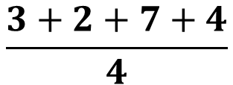
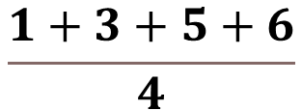
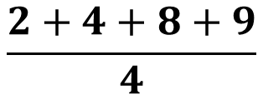
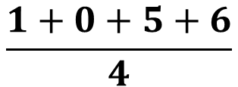
2×2 average pooling
1 | 3
5 | 6
2 | 4
8 | 9
1 | 3 | 2 | 4
5 | 6 | 8 | 9
3 | 2 | 1 | 0
7 | 4 | 5 | 6
$$\frac{1+3+5+6}{4}$$
= 3.75
$$\frac{2+4+8+9}{4}$$
= 5.75
3 | 2
7 | 4
1 | 0
5 | 6
$$\frac{3+2+7+4}{4}$$
$$\frac{1+0+5+6}{4}$$
= 3
= 4

Slide 45
2×2 Average pooling Output Feature Map
3.75 | 5.75
4 | 3
Each Sub region is represented by its AVERAGE value

Slide 46
Advantages of Average Pooling:
  Smooths Features: Average pooling gives a more smoothed representation by averaging the values within the region. This can be useful in certain tasks that require more context and not just peak activations.
  Less Aggressive Reduction: Compared to max pooling, it does not ignore non-maximum features and can be useful in cases where subtler patterns are important.
Disadvantages of Average Pooling:
  Loss of Prominent Features: Average pooling can lose some of the most important features or activations in a region because it averages all values, which may dilute the significance of sharp features like edges or corners.

Slide 47
ReLU Activation Function
The ReLU (Rectified Linear Unit) activation function is applied after each convolution layer and before pooling.
ReLU introduces non-linearity to the model by transforming the output of the convolution operation, ensuring that the network can learn complex patterns.

Slide 48
Where is ReLU Applied in This Process?

Slide 49
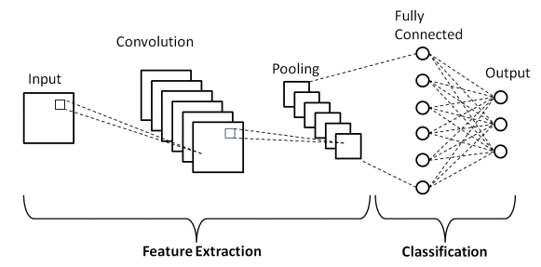
Basic Architecture of CNN

Slide 50
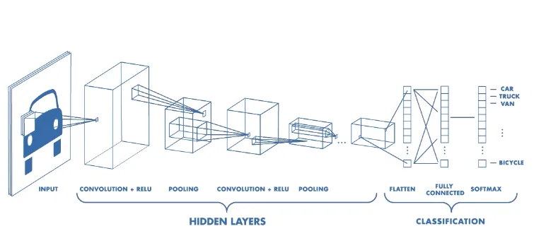
Basic Architecture of CNN

Slide 51
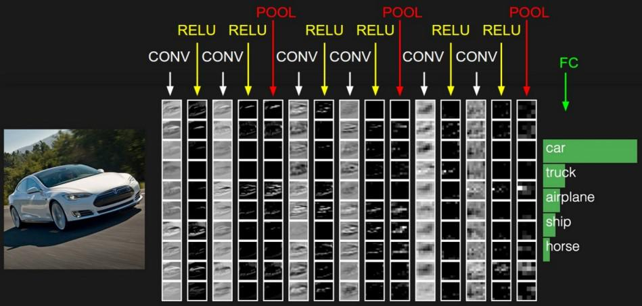
Basic Architecture of CNN

Slide 52
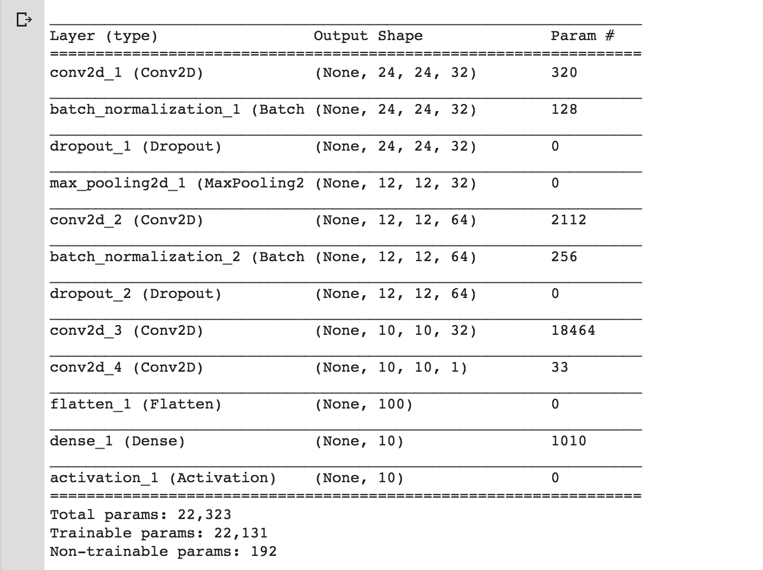

Slide 53
What Are Parameters in a Neural Network?
Parameters in a neural network typically refer to the weights and biases that are learned by the model during the training process.
These are the values that get adjusted through the backpropagation and optimization process to minimize the error between the predicted output and the actual labels.
  Convolutional layers: Each filter in a convolutional layer has a set of weights (parameters) that are applied to the input to extract features.
  Dense (Fully Connected) layers: Each neuron has weights that connect it to neurons in the previous layer and possibly a bias term.
  Batch Normalization: This layer has trainable parameters to adjust the normalization scale and shift (gamma and beta).

Slide 54
Conv2D_1 (Convolutional Layer)
Output Shape: (None, 24, 24, 32)This means the output has 32 feature maps (channels) and each feature map has dimensions of 24 x 24.
The first dimension (None) indicates the batch size, which is flexible and determined during runtime.
Parameters: 320
The number of parameters is calculated as:
  (3×3×1 (input channels)×32 (output channels))+32 (biases) = 320
Each filter is 3×3 and there are 32 filters, each associated with a bias term.

Slide 55
Batch Normalization
Output Shape: (None, 24, 24, 32)
Parameters: 128
This includes two trainable parameters: gamma and beta (scale and shift) for each feature map.
So, for 32 feature maps, we have: 32 (gamma)+32 (beta) = 64.
However, Batch Normalization also maintains moving averages of the mean and variance for normalization, but these are not trainable parameters.

Slide 56
Dropout
Output Shape: (None, 24, 24, 32)
Parameters: 0
Dropout does not have any trainable parameters.
It randomly drops out some neurons during training to prevent overfitting, but it doesn't modify weights directly.

Slide 57
Max Pooling
Output Shape: (None, 12, 12, 32)
Parameters: 0
Pooling layers do not have any trainable parameters.
They only down-sample the input to reduce the spatial size (by taking the maximum value in a region for max pooling, for example).

Slide 58
Conv2D_2 (Convolutional Layer)
Output Shape: (None, 12, 12, 64)
Parameters: 2,112
The number of parameters is calculated as:
(3×3×32 (input channels) × 64 (output channels))+64 (biases) = 2,112
Each filter is 3×3, and there are 64 filters applied to the 32 input channels.

Slide 59
Variants of the Basic Convolution Function
In the basic convolution operation, a kernel (or filter) is convolved with an input tensor to produce an output tensor, often referred to as a feature map.
Variants of this basic convolution operation have been developed to improve performance, efficiency, or handle specific tasks.

Slide 60
1. Convolution with Strides
Strided convolution means moving the convolution filter by more than one unit at a time across the input.
Stride > 1 reduces the spatial dimensions of the output, as the filter skips certain positions.
This is commonly used to reduce the computational load or control the size of the output feature map.

Slide 61
Convolution with Strides
Example: Consider a standard 3x3 convolution filter applied to a 7x7 input image. With a stride of 1, the filter moves one pixel at a time, resulting in an output size of 5x5. If we change the stride to 2, the filter jumps two pixels at a time, reducing the output size to 3x3. This speeds up computation and reduces the size of the output feature map, but with potential loss of detail.
Use Case: In image classification tasks, strided convolutions are often used to reduce spatial resolution progressively before fully connected layers (e.g., in architectures like VGGNet and ResNet).

Slide 62
2. Zero Padding (Padding)
Padding refers to adding extra pixels (typically zeroes) around the input image before applying the convolution.
This can:
  Preserve spatial dimensions: If padding is added, it allows the output to have the same width and height as the input (often referred to as "same padding").
  Avoid information loss: Without padding, the convolution filter would shrink the input size, and features near the borders could be underrepresented.

Slide 63
Zero Padding
Example: Without padding, a 3x3 convolution applied to a 7x7 image results in a 5x5 output. By adding zero padding (e.g., one pixel of padding on all sides), the output can be kept at 7x7, preserving the spatial size.
Use Case: In semantic segmentation, where pixel-level predictions are required, padding ensures that the output has the same spatial dimensions as the input image, allowing predictions for every pixel.

Slide 64
3. Dilated Convolution (Atrous Convolution)
In a dilated convolution, the filter is applied over a larger receptive field without increasing the number of parameters.
Dilation introduces gaps between the elements in the filter, allowing it to capture multi-scale information.
It's especially useful in tasks where the network needs to have a larger effective receptive field without increasing computational complexity, such as segmentation and some NLP tasks.

Slide 65
Dilated Convolution
Example: In a regular 3x3 convolution, each element of the filter covers a corresponding pixel of the input. With a dilation rate of 2, there is a gap of 1 pixel between the elements of the filter, effectively increasing the receptive field to 5x5 without adding extra parameters.
Use Case: DeepLab models for semantic segmentation use dilated convolutions to capture contextual information at multiple scales, allowing the model to “see” a larger area of the image while preserving computational efficiency.

Slide 66
4. Transposed Convolution (Deconvolution)
A transposed convolution is used to increase the spatial resolution of the input (up-sampling).
It reverses the spatial dimensions of the input, which is the opposite of what typical convolution does (down-sampling).
Commonly used in generative models like GANs or for tasks like image segmentation where you want to reconstruct higher-resolution outputs.

Slide 67
Transposed Convolution
Example: In a standard convolution, we reduce the input size. For instance, applying a 3x3 filter to a 5x5 input with a stride of 1 reduces the size to 3x3. A transposed convolution works in the opposite direction, up-sampling the 3x3 feature map back to 5x5.
Use Case: Generative Adversarial Networks (GANs) use transposed convolutions to generate high-resolution images from lower-dimensional latent spaces. For example, in DCGANs, transposed convolutions are used to progressively up-sample a low-resolution latent representation into a full-resolution image.

Slide 68
5. Separable Convolutions
Spatially Separable Convolution:
  A standard convolution filter is broken down into two smaller filters.
  For example, a 3x3 filter might be split into a 3x1 filter followed by a 1x3 filter, reducing computation.
Depth-wise Separable Convolution:
  This type of convolution factorizes a standard convolution into two steps:
    Depth-wise convolution: Applies a separate filter to each input channel.
    Pointwise convolution: Combines the outputs of the depth-wise convolution using a 1x1 convolution. This is computationally efficient and widely used in architectures like MobileNets.

Slide 69
Separable Convolutions
Example: A 3x3 filter over an RGB image (3 channels) typically requires 9 multiplications per channel for each position. In depth-wise separable convolutions, the 3x3 filter is first applied separately to each channel (reducing computation) and then combined via a 1x1 pointwise convolution.
Use Case: MobileNet utilizes depth-wise separable convolutions to build highly efficient models suitable for mobile and embedded applications by reducing the number of parameters and computations.

Slide 70
6. Grouped Convolution
Instead of applying a convolution across all input channels, the channels are divided into groups, and convolution is applied within each group.
This reduces computation and can be used to build more efficient networks.
Grouped convolution is a key component of architectures like AlexNet and ResNeXt.

Slide 71
Grouped Convolution
Example: In a standard convolution, if we have 64 input channels and apply a 3x3 filter, the filter spans all 64 channels. In grouped convolutions, the input channels are split into groups (e.g., 2 groups of 32 channels each), and separate filters are applied to each group. This reduces the number of connections and parameters.
Use Case: AlexNet uses grouped convolutions to distribute the workload across two GPUs. ResNeXt further develops this idea, using grouped convolutions to increase model capacity efficiently by splitting filters into multiple groups.

Slide 72
Structured Outputs

Slide 73
Structured outputs in Convolutional Neural Networks (CNNs) refer to outputs that have a specific format or structure, often involving complex relationships between output elements rather than producing a single scalar or a simple label.
This is essential for tasks where the output needs to convey more information than just a single classification.
Approaches to Structured Output:
  Multi-task learning.
  Region Proposal Networks (RPN)
  Conditional Random Fields (CRFs)

Slide 74
Multi-task learning:
  A single model is trained to predict multiple outputs simultaneously.
Region Proposal Networks (RPN):
  Used in object detection, they generate possible regions where objects could be located.
Conditional Random Fields (CRFs):
  These can be combined with deep networks (e.g., for segmentation tasks) to model the dependencies between output variables.

Slide 75
Structured Output : Example 1
Image Segmentation:
  Task: Classifying each pixel in an image into different categories (e.g., background, car, road).
  Output: A 2D grid where each element corresponds to the class label of a pixel.
    For instance, a segmentation output for a 256x256 image will be a 256x256 matrix with class labels for each pixel.
    Image segmentation example output where each pixel is labeled with a class.

Slide 76
Structured Output : Example 2
Object Detection:
  Task: Detecting and localizing multiple objects within an image.
  Output: For each detected object, the output includes bounding box coordinates (x, y, width, height) and the corresponding class label (e.g., car, pedestrian).
    This might result in a structured output like a list of bounding boxes and labels.
    Object detection output example with bounding boxes and class labels.

Slide 77
Structured Output : Example 3
Keypoint Detection:
  Task: Identifying specific points of interest in images (e.g., human pose estimation).
  Output: A set of keypoint coordinates (x, y) corresponding to different parts of an object (e.g., joints of a human body).
    The output structure typically includes multiple keypoints and can also indicate confidence scores for each keypoint.
    Keypoint detection output showing keypoints for human pose estimation.

Slide 78
Structured Output : Example 4
Sequence-to-Sequence Tasks:
  Task: Tasks like machine translation or text summarization, where the model outputs a sequence based on an input sequence.
  Output: For example, translating a sentence in English to French, where the output is a sequence of words in the target language, each possibly influenced by previous outputs.

Slide 79
DATA TYPES

Slide 80
Convolutional networks are typically applied to grid-like data (e.g., images), but the principles can extend to other types of data:
Image Data (2D grids): The most common application of ConvNets, where the input data is a 2D grid of pixel values (height x width).
Video Data (3D grids): Video can be considered a sequence of images, or a 3D grid of data (height x width x time). ConvNets can be extended to handle this by using 3D convolution, where filters slide over time as well as spatial dimensions.
Text Data (1D sequences): In NLP tasks, text is usually represented as a sequence of words (or characters). While recurrent networks (RNNs) are more common for handling sequences, ConvNets can also be applied. In this case, 1D convolutions are used over the sequence.

Slide 81
Graph Data: Although not a grid, data can be represented as graphs (e.g., social networks, molecular structures). Graph Convolutional Networks (GCNs) have been developed to generalize convolutions to work on graphs.
Audio Data (1D signals): Audio can be represented as a 1D time-series signal. ConvNets are applied to raw waveforms, spectrograms, or other representations of sound.

Slide 82
Image Data
Example: Standard image classification tasks, such as classifying an image of a dog or cat, rely on applying 2D convolutions to image inputs, which are represented as 2D grids of pixel values (height x width).
Use Case: Networks like VGGNet, ResNet, and Inception architectures apply convolutions to 2D images for object recognition tasks like ImageNet classification.

Slide 83
Video Data
Example: A video can be thought of as a stack of frames (images) over time. Each frame is a 2D grid, and the video as a whole is a 3D grid (height x width x time). A 3D convolution can process not just the spatial dimensions but also the temporal dimension.
Use Case: 3D ConvNets are used for action recognition in video clips, such as detecting whether someone is running, jumping, or dancing.

Slide 84
Text Data
Example: In NLP, text data is typically represented as a sequence of word embeddings. 1D convolutions can slide filters over these embeddings to capture local patterns, such as phrases or word combinations.
Use Case: Text classification models such as character-level CNNs or sentence classification networks use 1D convolutions to capture features from text sequences, like sentiment analysis or spam detection.

Slide 85
Graph Data
Example: In a graph, nodes represent entities, and edges represent relationships between them. Graph Convolutional Networks (GCNs) generalize the concept of convolution to graphs by learning to aggregate information from neighboring nodes.
Use Case: Social network analysis uses GCNs to predict connections between people or detect communities. In molecular chemistry, GCNs help predict molecular properties by analyzing graph-like representations of molecules.

Slide 86
Audio Data
Example: An audio signal is a 1D time-series data. 1D convolutions can be applied to capture temporal features in the waveform, such as the pitch or rhythm.
Use Case: Speech recognition models, such as WaveNet, use 1D convolutions to process raw audio data for tasks like transcribing spoken language.

Slide 87
Efficient Convolution Algorithms
Basic Concept of Convolution
  In CNNs, the convolution operation is used to extract features from data (e.g., images).
  Typically, a kernel (or filter) slides over the input, performing element-wise multiplications and summing the results, which captures spatial information.
Challenges with Convolutions
  Convolutions, especially in high-dimensional data (e.g., images with large dimensions and multiple channels), can be computationally expensive.
  The main goal of efficient convolution algorithms is to reduce the computational cost while retaining accuracy.

Slide 88
Efficient Convolution Algorithms
Several algorithmic approaches to make convolutions more efficient:
FFT-based Convolutions:
  By using the Fast Fourier Transform (FFT), convolution can be converted into element-wise multiplication in the frequency domain.
  This is more computationally efficient for large kernel sizes because FFTs reduce the complexity from 𝑂(𝑛²) to 𝑂(𝑛log⁡𝑛) per image.
  However, FFT-based convolution can introduce some overhead due to padding and may not be as efficient for small kernels (e.g., 3x3 filters).

Slide 89
Efficient Convolution Algorithms
Winograd Convolution Algorithm:
  Winograd's algorithm is highly efficient for small filters, like 3x3, and uses a minimal number of multiplications.
  By restructuring the convolution process, it reduces the number of required arithmetic operations by transforming the convolution problem into a series of smaller multiplications and additions.
  Winograd convolution is well-suited for hardware acceleration because of its reduced complexity.

Slide 90
Efficient Convolution Algorithms
Strassen Multiplication:
  Strassen’s algorithm is used in some contexts to speed up matrix multiplications by reducing the number of multiplication operations required.
  This approach is not always applied directly in CNNs but is part of the family of ideas used in efficient convolution techniques.

Slide 91
Efficient Convolution Algorithms
Separability of Kernels:
  For specific types of kernels (e.g., Gaussian blur), separability allows a 2D convolution to be broken down into two 1D convolutions (one for each dimension).
  This reduces the computation from 𝑂(𝑛²) to O(n) for each axis, saving resources and improving speed without needing complex algorithms.

Slide 92
Efficient Convolution Algorithms
Grouped Convolutions and Depth-wise Convolutions:
  Grouped convolutions split the input channels into groups, allowing separate convolutions within each group.
  Suppose we have 8 input channels and want to use 4 groups in a convolution layer. We split the 8 input channels into 4 groups of 2 channels each, and then we apply convolution separately within each group. Each group has its own filter(s) that do not interact with the other groups.
  Benefits: This reduces the computational cost because we are only computing convolutions within smaller groups instead of across all channels. Additionally, grouped convolutions enable more flexible and modular filter architectures.
  Depth-wise separable convolutions divide the standard convolution into two parts:
    Depth-wise convolution (each channel independently) and pointwise convolution (combines results across channels).These are widely used in modern CNN architectures (e.g., MobileNet) for efficiency, especially in mobile or embedded systems.

Slide 93
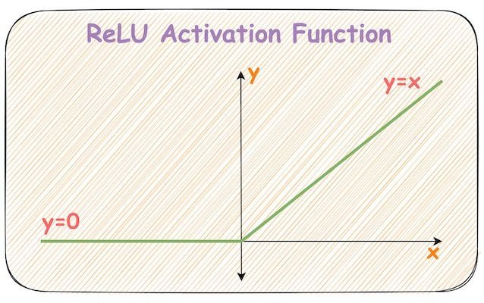
ReLu AF
ReLU formula is : f(x) = max(0,x)
This means that if the input value 𝑥 is positive, the output is 𝑥. If 𝑥 is negative or zero, the output is zero.
In other words, ReLU keeps positive values unchanged and replaces all negative values with zero.

Slide 94
Key Properties of ReLU
Non-Linearity:
  ReLU introduces non-linearity to the network, allowing it to learn complex patterns.
Simplicity and Efficiency:
  ReLU is computationally efficient because it only requires a simple thresholding operation, making it faster than other activation functions like sigmoid or tanh. This efficiency is especially useful in deep networks, where many neurons need to be activated per layer.
Sparsity:
  By setting negative values to zero, ReLU makes the network sparse, meaning only a subset of neurons are activated at any time. Sparse representations reduce the computational load and can help with feature extraction by allowing the network to focus on important features.

Slide 95
Advantages
Reduces the Vanishing Gradient Problem:
  Unlike the sigmoid or tanh functions, which can cause gradients to shrink towards zero (making training slow), ReLU’s gradient is either 1 (for positive inputs) or 0 (for negative inputs). This allows gradients to remain large enough to propagate through many layers, speeding up training in deep networks.
Faster Convergence:
  ReLU’s simple derivative properties make it easier for optimization algorithms to adjust weights, often resulting in faster convergence during training compared to saturating functions like sigmoid.

Slide 96
Disadvantages
Dying ReLU Problem:
  In some cases, neurons can get stuck with negative values and thus output zero for all inputs. This “dead” neuron problem can occur during training if the input values lead to weights that produce consistently negative outputs. Once a neuron is dead, it no longer contributes to learning, reducing the model's capacity.
Not Zero-Centered:
  ReLU outputs only positive values, which means the average activation can be greater than zero. This non-zero mean can sometimes slow down convergence, though this effect is generally minimal compared to the advantages of ReLU.

Slide 97
AlexNet
AlexNet was a breakthrough convolutional neural network (CNN) model that emerged in 2012 and set a new standard for deep learning in computer vision.
It was developed by Alex Krizhevsky, Ilya Sutskever, and their advisor Geoffrey Hinton at the University of Toronto

Slide 98
Background in Computer Vision and ImageNet
ImageNet Dataset: Around 2009, Fei-Fei Li and her team at Stanford introduced ImageNet, a large-scale dataset of millions of labeled images across thousands of categories. The sheer size of ImageNet presented a unique challenge for developing algorithms capable of learning effectively from vast, diverse visual data.
Challenges in Traditional Methods: Prior to AlexNet, most computer vision techniques relied on hand-crafted feature extraction methods like SIFT or HOG, which had limited success in tasks with significant variation (like ImageNet) and often required task-specific tuning.

Slide 99
Design of AlexNet
Eight Layers:
  It consisted of five convolutional layers followed by three fully connected layers, making it one of the deepest networks at the time.
ReLU Activation Function:
  AlexNet used Rectified Linear Units (ReLUs) instead of traditional sigmoid or tanh activations. ReLUs reduce issues like vanishing gradients and improve convergence speed.
Overlapping Pooling:
  AlexNet used overlapping max-pooling layers, which improved the model’s ability to generalize and reduced the risk of overfitting.

Slide 100
Design of AlexNet
Dropout for Regularization:
  To prevent overfitting, AlexNet introduced dropout in the fully connected layers, randomly dropping units during training to encourage the network to develop more robust feature representations.
Data Augmentation:
  To artificially expand the dataset and reduce overfitting, AlexNet used techniques like image translation, horizontal flipping, and changing color intensities.

Slide 101
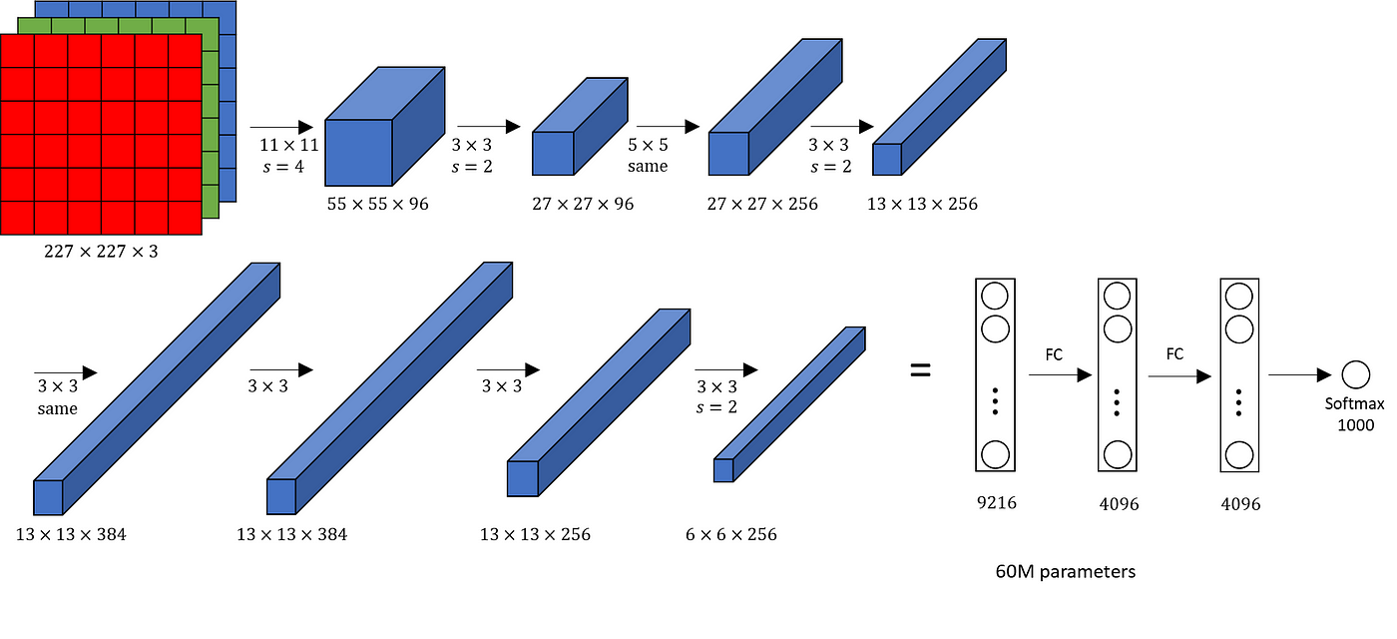
Architecture

Slide 102
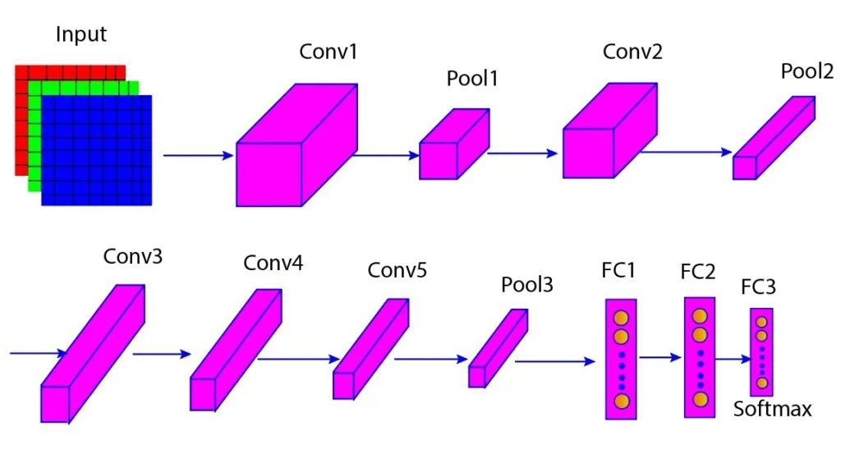

Slide 103
Architecture and Layers:
AlexNet consists of five convolutional layers followed by three fully connected layers. It uses max-pooling layers to reduce spatial dimensions and dropout layers to prevent overfitting.
The network was designed with ReLU (Rectified Linear Unit) activation functions, which improve training speed compared to traditional activation functions like sigmoid or tanh by preventing saturation and facilitating faster gradient-based optimization.

Slide 104
Dataset:
Trained on the ImageNet dataset, AlexNet used 1.2 million training images, 50,000 validation images, and 150,000 testing images. The model's input images were down-sampled and cropped to 256x256 pixels, and mean normalization was applied for preprocessing.
Local Response Normalization (LRN):
This technique was used to improve generalization. It normalizes a neuron’s output based on the activity of neighboring neurons, which helped reduce error rates by maintaining a diverse range of activations across layers.

Slide 105
Overlapping Pooling:
Unlike traditional pooling, where regions are non-overlapping, AlexNet’s use of overlapping pooling allows neighboring regions to contribute to the pooled result, reducing error rates and improving feature extraction.
Data Augmentation:
To reduce overfitting, two data augmentation techniques were used: image translations and horizontal reflections and adjustments to intensity of RGB channels. This allowed the network to generalize better by creating variations in the training data.

Slide 106
Dropout Regularization:
Dropout was used to set random neurons’ outputs to zero with a 0.5 probability during training, making AlexNet more robust by forcing it to learn redundant representations. Although it doubled the required training time, it effectively prevented overfitting.
Stochastic Gradient Descent (SGD):
The network used SGD with a batch size of 128 to minimize the cross-entropy loss function. Learning rates were adaptively adjusted, and momentum and weight decay were used to stabilize and accelerate convergence during training.

Slide 107
Multi-GPU Training:
AlexNet was one of the first models to leverage multiple GPUs for training. Half of the neurons in certain layers were assigned to each GPU, with inter-GPU communication occurring selectively to reduce training time and improve performance.

Slide 108
Example:
Suppose we input a 224x224x3 RGB image of a cat into AlexNet.
The network processes this image through the following stages:
1. Input LayerInput:
  A 224x224x3 image.
  AlexNet actually resizes the input to 227x227x3 using padding or resizing for compatibility with its specific architecture.
  Why Resize?
    Filter and Stride Requirements: In AlexNet, the first layer’s filter size is 11x11 with a stride of 4.

Slide 109
Fixed Filter Sizes:
Each convolutional layer in AlexNet has a set filter size, optimized for image feature extraction. For example, the first convolutional layer uses an 11x11 filter, the second layer uses a 5x5 filter, and subsequent layers use 3x3 filters.These filter sizes are fixed throughout training and do not change dynamically.
Fixed Input Size:
The input image dimensions for AlexNet are standardized to 256x256 pixels. During preprocessing, images are down-sampled and cropped to this fixed size to maintain uniformity across the dataset, ensuring that every image input has the same dimensions.

Slide 110
First Convolutional Layer (Conv1)Filters:
  96 filters of size 11x11 with a stride of 4.
  Output: After applying 96 filters, we get a 55x55x96 feature map.
  Activation: ReLU activation is applied after convolution to introduce non-linearity.
  Pooling: Max pooling with a 3x3 filter and stride of 2, reducing output to 27x27x96.

Slide 111
Second Convolutional Layer (Conv2)Filters:
  256 filters of size 5x5 with stride 1.
  Output: Results in a 27x27x256 feature map after convolution and ReLU.
  Pooling: Max pooling with a 3x3 filter and stride of 2, reducing output to 13x13x256.

Slide 112
Why different size filter for different layers?
First Convolutional Layer (11x11 filter):
  Large Receptive Field: The 11×11 filter in the first layer covers a larger area of the input image, allowing it to capture low-level features such as edges, textures, and colors over a larger spatial context.
  Large Stride (4): With a stride of 4, the filter skips pixels to reduce computation and quickly down-sample the image size, which also helps in managing the large input image dimensions (227x227).Reason: Since initial layers detect basic features, larger filters help capture more spatially extended patterns.

Slide 113
Why different size filter for different layers?
Second Convolutional Layer (5x5 filter):
  Intermediate Receptive Field: As the network moves deeper, the filters are smaller, allowing the network to capture finer details of the features detected by the first layer.
  Reason: The second layer builds on the low-level features detected in the first layer to recognize more complex patterns, so a 5×5 filter size provides a good balance of detail and abstraction.

Slide 114
Why different size filter for different layers?
Third, Fourth, and Fifth Convolutional Layers (3x3 filters):
  Small Receptive Field: In these deeper layers, the 3×3 filters are focused on small details, combining and refining features detected by the previous layers.
  These filters allow the network to capture intricate patterns like shapes, textures, and object parts.
  Reason: Smaller filters in deeper layers are more efficient and computationally less intensive. Since the network has already down-sampled the spatial dimensions by this point, these smaller filters can capture highly specific, fine-grained details needed for classification.

Slide 115
Why various sizes of pooling and overlapping?
Balance Between Dimensionality Reduction and Information Retention
  Larger Pooling Sizes
  Smaller Pooling Sizes
Control Overfitting
Preserving Feature Localization
Spatial Invariance

Slide 116
Advantages
Breakthrough in Deep Learning and CNNs:
AlexNet’s success in the 2012 ImageNet competition demonstrated the effectiveness of deep learning and CNNs for large-scale image classification, establishing CNNs as the standard for many computer vision tasks.
Efficient Use of GPUs:
AlexNet was one of the first models to leverage multiple GPUs for training, which greatly reduced the training time on large datasets. This approach paved the way for further advancements in model parallelism.

Slide 117
Introduction of Key Techniques:
AlexNet introduced several techniques that improved performance and training efficiency, including:
  ReLU activation functions: Faster convergence compared to traditional activation functions like sigmoid or tanh.
  Dropout regularization: Helped reduce overfitting by randomly setting neuron outputs to zero during training, which made the model more robust.
  Data augmentation: Increased the size and diversity of training data by applying transformations like image flipping and color variation, helping improve generalization.

Slide 118
Disadvantages of AlexNet
Large Memory and Computational Requirements:
  AlexNet’s architecture, though efficient at the time, is relatively large and computationally demanding. The model has millions of parameters, which require significant memory and computational power for both training and inference.
High Overfitting Tendency:
  While dropout helped address overfitting, AlexNet still has a large number of parameters, making it prone to overfitting on smaller datasets. Newer architectures like VGG and ResNet incorporate additional strategies to further mitigate overfitting.

Slide 119
No Batch Normalization:
  AlexNet does not include batch normalization, which was later introduced to improve training stability and speed by normalizing layer inputs. Batch normalization is now standard in most deep networks, as it addresses internal covariate shift and allows for higher learning rates.
Fixed Filter Sizes:
  AlexNet uses fixed filter sizes (e.g., 11x11, 5x5), which limits its flexibility in capturing multi-scale features. Newer architectures, like Inception and ResNet, use a combination of different filter sizes within the same layer, enabling better feature extraction.

Slide 120
Lack of Depth and Efficiency Compared to Modern Architectures:
  With only 5 convolutional layers, AlexNet is relatively shallow compared to newer architectures (e.g., VGG with 16-19 layers, ResNet with 50+ layers), which often outperform AlexNet on complex tasks due to their greater capacity to learn hierarchical features.

Slide 121
LeNet
The LeNet model is one of the earliest convolutional neural networks (CNNs) designed for image recognition tasks.
It was developed by Yann LeCun and his collaborators in the late 1980s and early 1990s, and it became widely known for its application in handwritten digit recognition on the MNIST dataset.

Slide 122
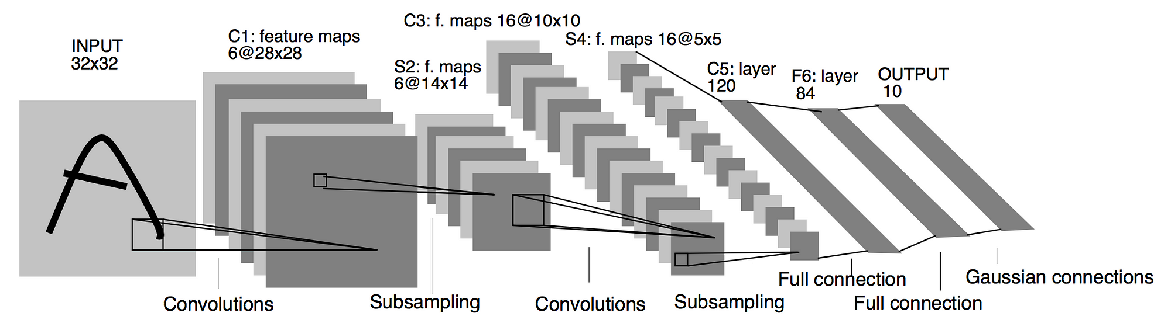

Slide 123
Architecture of LeNet
Input Layer:
  The input to the model is a 32x32 grayscale image (e.g., handwritten digit images).
  Since MNIST images are typically 28x28, they’re usually zero-padded to 32x32 to preserve edge features better during convolution.
C1 - Convolutional Layer:
  Applies 6 convolutional filters of size 5x5 with a stride of 1.
  Produces 6 feature maps of size 28x28 (the original size of MNIST images).
  Extracts low-level features from the input image, such as edges, textures, and shapes.

Slide 124
S2 – Sub-sampling (Pooling) Layer:
  Applies average pooling with a 2x2 filter and a stride of 2, reducing each feature map size to 14x14x6.
  This layer also uses a learnable parameter to adjust the pooled output.
  Reduces the spatial dimensions of each feature map from 28x28 to 14x14, effectively down-sampling the feature maps.
  This reduces the amount of computation in later layers, makes the network more robust to small spatial shifts in the input, and helps reduce overfitting.
C3 - Convolutional Layer:
  Applies 16 convolutional filters of size 5x5, producing 16 feature maps of size 10x10 and Stride: 1.
    Connectivity Pattern:
      Not all of the 6 input channels from S2 are connected to every output channel in C3. Instead, a partial connection pattern was used to reduce the number of parameters while preserving important spatial information.
    Purpose:
      Captures more complex features by learning to combine features extracted in the first convolutional layer. Each of the 16 filters detects different patterns across the spatial locations of the 6 input feature maps from the previous layer.

Slide 125
S4 - Subsampling (Pooling) Layer:
  Similar to S2, it applies 2x2 average pooling, reducing each feature map to 5x5, with Stride =2.
  Purpose:
    Similar to the first pooling layer, this layer down-samples the feature maps from 10x10 to 5x5, further reducing the spatial dimensions. It helps generalize the network by focusing on essential spatial patterns and discarding finer details, which may help improve translation invariance.
C5 - Convolutional Layer:
  This layer has 120 filters of size 5x5 (fully connected to the 5x5 input from S4), resulting in a 1x1 output per filter, producing 120 feature maps of size 1x1, stride = 1.
  Connectivity Pattern:
    Each filter in this layer is connected to all 16 feature maps of the previous layer (S4), making it fully connected spatially.
  Purpose:
    Since the input to this layer is 5x5, applying a 5x5 filter with a stride of 1 effectively collapses each feature map into a single scalar value. This layer captures high-level, abstract patterns by combining information from the previous layers and outputs 120 distinct feature maps of size 1x1.

Slide 126
Architecture of LeNet
F6 - Fully Connected Layer:
  This layer is a fully connected layer with 84 units, which applies the sigmoid activation. The 84 units were chosen to resemble the structure of the hidden layer in earlier neural network architectures. This layer helps combine all the learned features to detect more complex patterns and relationships and prepares the data for classification.
Output Layer:
  The final layer is a fully connected layer with 10 units, corresponding to the 10 digit classes (0 to 9).
  Uses a softmax activation function to output probabilities for each class.
  This final layer provides the classification output. Each of the 10 units outputs the probability of the input image belonging to one of the 10 digit classes. The class with the highest probability is chosen as the predicted label.

Slide 127
Characteristics of LeNet
Convolutional and Pooling Layers:
  LeNet’s convolutional and pooling layers allow it to capture spatial hierarchies in images, learning increasingly complex features.
Parameter Efficiency:
  Its small number of parameters makes it relatively lightweight compared to modern deep networks.
Pioneering Architecture:
  LeNet-5 set the foundation for many CNN models that followed, showcasing the effectiveness of convolutional and pooling layers.

Slide 128
Characteristics of LeNet
Layer Progression:
  LeNet-5 follows a structure of alternating convolutional and pooling layers, with convolutional layers extracting features and pooling layers downsampling the feature maps.
Fully Connected Layers:
  At the end, fully connected layers interpret the feature maps to produce the final classification.
Early Use of CNN Principles:
  Although relatively simple, LeNet-5 effectively showcases key CNN principles like local receptive fields, shared weights, and downsampling, which have influenced the design of modern CNN architectures.

Slide 129
Advantages of LeNet
Foundational Architecture:
  LeNet introduced core CNN concepts like convolutional and pooling layers, weight sharing, and local receptive fields, which inspired modern CNN designs. Its simplicity and modular structure make it easy to understand, serving as a foundational learning model for beginners in deep learning.
Low Computational Cost:
  With relatively few parameters compared to modern CNNs, LeNet is computationally lightweight. This makes it ideal for low-power devices or environments with limited computational resources.

Slide 130
Effective for Simple, Low-Resolution Images:
  LeNet was highly effective for tasks involving simple, low-resolution grayscale images, like handwritten digit recognition on the MNIST dataset. It performs well on these tasks despite its limited depth and complexity.
Reduces Overfitting:
  LeNet’s use of pooling layers and relatively few parameters helps to control overfitting on smaller datasets, as it reduces the risk of memorizing patterns that don't generalize well.
Efficient Training:
  Due to its simplicity and relatively shallow architecture, LeNet can train relatively quickly and doesn’t require the vast datasets and computational resources needed for deeper CNNs.

Slide 131
Disadvantages of LeNet
Limited to Simple, Small-Scale Images:
  LeNet’s design is optimized for small, grayscale images (like 32x32 MNIST images), making it less suitable for complex, high-resolution color images (such as those in CIFAR-10 or ImageNet). It lacks the capacity to handle high-level feature hierarchies present in more intricate datasets.
Shallow Network Depth:
  With only a few convolutional layers, LeNet lacks the depth needed for learning complex and abstract representations. Modern tasks typically require much deeper architectures to capture subtle patterns and achieve high performance on challenging datasets.

Slide 132
Outdated Activation Functions:
  LeNet originally used the sigmoid activation function, which can lead to problems like vanishing gradients. Most modern CNNs use ReLU or its variants to address this, leading to faster and more stable training.
Limited Pooling Strategy:
  LeNet uses average pooling, whereas max pooling has since proven more effective at preserving essential features and improving generalization by focusing on the most prominent signals.
Inefficient for Large Datasets and Applications:
  LeNet does not scale well to larger, more diverse datasets, as its small filter size and layer count limit its representational power. For large-scale image classification tasks, modern networks like AlexNet, VGG, and ResNet are far more effective.

